Slide 1
ATOM: Democratizing Drug Discovery
Eric Stahlberg Ph.D.
Director, Biomedical Informatics and Data Science – Frederick National Laboratory for Cancer Research
Co-lead ATOM Consortium
2021 NCI and FNL Technology Showcase

Slide 2
www.atomscience.org
Key points:
Accelerating Computational Drug Discovery
Open Platform and Ecosystem
Democratizing Drug Discovery

Slide 3
The goal of ATOM is to accelerate and democratize drug discovery and optimization
We’ll do this by ….
Demonstrating acceleration and effectiveness of AI and computing-driven molecular discovery and optimization
Developing, validating, and releasing an open platform for molecular discovery and design
Applying the platform to making molecules for work on cancer, infectious disease, and underserved needs in the public good
Notes:
Initially we will be simply assign a score for each molecule from the virtual screen and rank them.
Next will be a stretch goal – and dependent on resources (e.g. people, time and priorities).
Will need to train autoencoder on ~100K molecules predicted to be best from our initial virtual screen. (potentially do-able, from Kevin or possibly Derek)
Will need to be able to call ConveyorLC from the design loop. (extra effort)

Slide 4
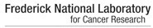













The ATOM Public-private Consortium Experiment: Can independent government entities and private industry work together to expedite drug discovery?
Founding Organizations
October, 2017
Experimental biology, data analytics, open data and models
Cancer biology and new assay development
High performance computing, data science, and molecular design
Drug discovery, chemistry, and historical dark data
Founding Vision
Academic
Subsequent R&D Collaborations and Partners
Cancer Centers
High-performance computing
Pharma
Tech
Gov’t Labs
ATOM CRADA
Partners
Notes:
Small Molecules
Cancer target first
Mention that GSK is funding ATOM Fellows in year 4

Slide 5
The ATOM molecular design process integrates predictive models, multi-parameter optimization, and active learning
ATOM products
Molecular data library - Open curated and model-ready database
AMPL - Predictive modeling platforms - training, optimization, and property prediction
LBANN – Computing platform for generative molecular models
GMD - A high-performance platform for parallel optimization of efficacy, safety, and pharmacokinetics
Pilot design projects in cancer, infectious disease and other areas
AMPL – ATOM Modeling PlpeLine
LBANN – Livermore Big Artificial Neural Network
GMD – Generative Molecular Design
Notes:
Initially we will be simply assign a score for each molecule from the virtual screen and rank them.
Next will be a stretch goal – and dependent on resources (e.g. people, time and priorities).
Will need to train autoencoder on ~100K molecules predicted to be best from our initial virtual screen. (potentially do-able, from Kevin or possibly Derek)
Will need to be able to call ConveyorLC from the design loop. (extra effort)

Slide 6
ATOM Modeling Pipeline (AMPL)
An open-source, modular, extensible software pipeline for building models
Data Ingestion + Curation
Model Training + Tuning
Featurization
Prediction Generation
Visualization + Analysis
Data Lake
Model Zoo
Results DB
Benefits:
Easy integration of diverse datasets
Enables portability of models and reproducibility of results
Rapid exploration of descriptors and model architectures for each data set
AMPL is available at https://github.com/ATOMconsortium/AMPL and in J. Chem. Inf. Model. 2020, 60, 4, 1955–1968.
Notes:
Operating at LLNL, Cloud, FNL and NIH Biowulf
Available on GitHub
Has training examples, readily downloadable and in use broadly with groups and in courses.
Looking to closely integrate into MoDaC for easy access to MoDaC data and models.
AMPL capabilities…
Neural Nets (NN) and Random Forest (RF) Models
ECFP, MOE descriptor vectors, Mordred descriptor vectors, and Graph Convolution-based features
NN: Vary learning rate, # of layers, layer size, dropout rate
RF: Vary max depth and number of estimators
20,681 total models for 169 Safety and PK datasets
15,972 Regression models
4,709 Classification models

Slide 7





Model and Data Clearinghouse (MoDaC) Distributing collaborative models and data to the community
Public facing web application
Extensible metadata structure
Configurable access levels
Data transfer options
AWS S3, Globus, Local
Data Management options
Upload (pre-approved users)
Download (registered users)
Search (all)
Advanced model support
Additional endpoint types
Bridge to the broader cancer data ecosystem
Data Services API Core
Web Application
User Database
Transfer
Endpoints
Metadata Server
Globus
Data
Metadata Store
Local
Object Repository
MoDaC URL: modac.cancer.gov

Slide 8
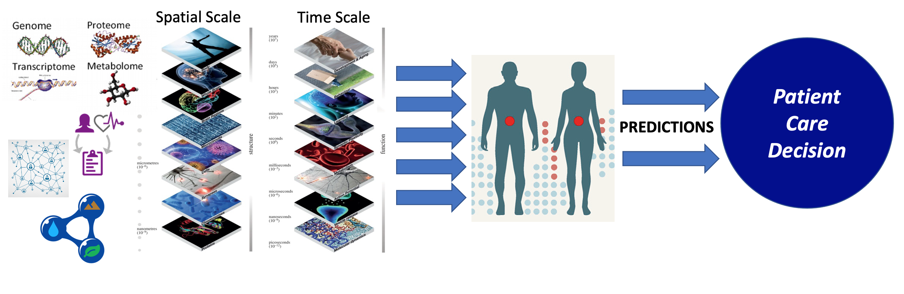
The Challenge: Digital Twin for Predictive Oncology
Patient-tailored models incorporating multi-omic, clinical, environmental and social data that can evaluate and predict the most effective prevention and therapeutic plans

Slide 9
ATOM Student Engagement Programs
ATOM summer traineeships:
Students from Butler University PharmD, UC Davis, Nova Southeastern University
FNL/NCI ATOM Fellowship Program:
ATOM hosted 4 fellows
Hiring next group of fellows
Purdue University Data Mine Program:
Support a data science team (~10 students)
Focusing on data analysis and machine learning applications with AMPL
Trainees among ATOM member labs
Summer 2020 Trainee Projects
Data Curation for a Mitochondrial Membrane Potential Model
Public Datasets within AMPL
Visualize Data: Creating Interactive Plots to Improve Exploratory Data Analysis
Working with Open Data Sources: PK DB, Lombardo Dataset, and AstraZeneca
Featurization and Analysis of COVID-19 data
Explainable 3D-CNN Models for Protein-Ligand Binding
Notes:
An important outcome of ATOM is also building the workforce, preparing the scientists of the future with skills in the integrated discovery environment. Working with the future leaders is proving out as a very productive interaction for all.
In addition to the ATOM fellows program, which has now been in place for a couple of years, ATOM expanded to include interns this summer – despite the COVID-19 challenge. ATOM was able to virtually host several students in Butler University’s pharmD program and from UC Davis over 8 weeks this summer – working with the public data and released AMPL workflow. It was very impressive to hear what these ATOM interns and their mentors accomplished over the summer where you see a list of projects on the right-hand side.
A final important note about these internships is that the idea has its origins with pharma. The relationship between Butler University and Eli Lilly led to the development of these internships as valuable to the industry.
ATOM continues to support trainees in ATOM member labs, with ATOM also now collaborating with the Purdue University Data Mine program where a team of students will work together on data analysis and machine learning applications with AMPL.

Slide 10

Contact us
Experts in fields from machine learning to cancer biology with a goal to accelerate drug discovery (www.atomscience.org)
Acknowledgements
Founding members
ATOM AMPL team
ATOM DILI, PK, GMD teams
(for more information)
Eric Stahlberg, Ph.D.
ATOM Co-lead &
Director, Biomedical Informatics & Data Science Frederick National Laboratory
Eric.Stahlberg@nih.gov
(for Partnership Interest)
Vladimir Popov, Ph.D.
Director, Partnership Development Office
Frederick National Laboratory
301-846-5737
Vladimir.Popov@nih.gov

